Slide 1

SYMPTOM-BASED DISEASE PREDICTION SYSTEM USING MACHINE LEARNING
EE363- Introduction to Machine learning
Course Co-ordinator – Dr. K. Sri Phani Krishna
Animini Hemesh - 521113
Bandi Rahul- 521120
Doddipalli Ajith – 521130
Class : Btech 3rd year sec-A

Slide 2
INTRODUCTION
As the number of patients and diseases continues to increase annually, the strain on the medical system grows, leading to overpricing in many countries. A majority of illnesses necessitate consultations with doctors for treatment. Leveraging ample data, algorithms can streamline and economize disease prediction. Symptom-based disease prediction is a vital component of effective treatment. In our project, we endeavor to precisely forecast diseases based on patient symptoms. We employed two distinct algorithms, Decision Tree and KNN, and attained an accuracy level close to 90%. This system harbors immense potential for future medical treatments. Additionally, we crafted an interactive interface to enrich user-system interaction. Furthermore, we strived to visually depict and interpret the findings of our study and project.

Slide 3
MODELS
In this project, both Decision Tree and K-Nearest Neighbors (KNN) models were employed to predict diseases based on symptoms. The Decision Tree model was trained to create a tree-like structure where each internal node represented a decision based on a symptom, and each leaf node represented the predicted disease. During training, the model learned to partition the feature space (symptoms) based on information gain or Gini impurity. In contrast, the KNN model stored the entire training dataset without explicit decision rules. During prediction, KNN calculated distances between new symptoms and all training instances, selecting the K nearest neighbors and assigning the majority class label among them as the prediction. Both models were evaluated using cross-validation and tested on separate datasets, with accuracy scores and confusion matrices used to assess their performance in disease prediction.

Slide 4
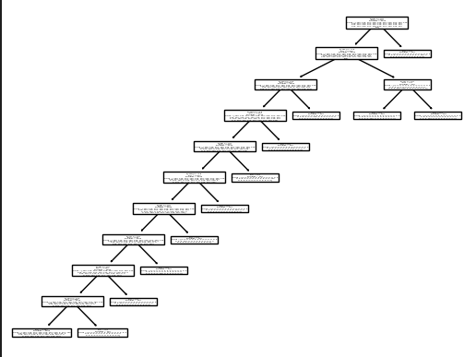
DECISION TREE
Utilized for disease prediction based on symptoms.
Learns decision rules from training data to create a tree-like structure.
Each node represents a decision based on a symptom, aiding in partitioning the feature space for accurate predictions.

Slide 5
K-NEAREST NEIGHBOURS
KNN relies on the principle of similarity between instances.
It stores the entire training dataset and does not learn explicit decision rules.
The choice of K, the number of neighbors, influences its performance.
KNN assigns the majority class label among its K nearest neighbors during prediction.
It can be computationally expensive with large datasets due to distance calculations.

Slide 6
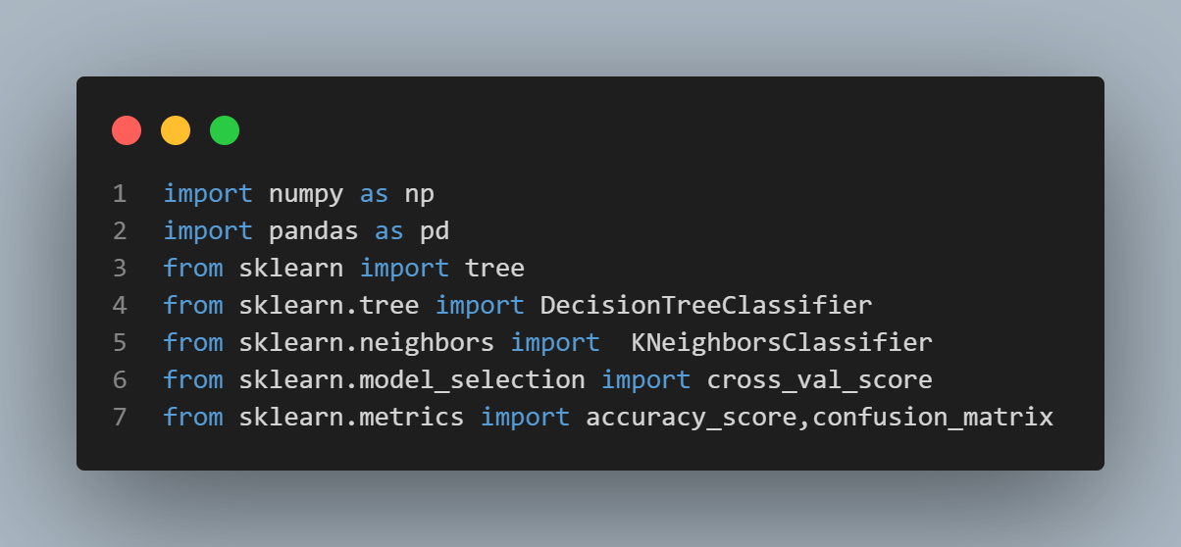
LIBRARY USED

Slide 7
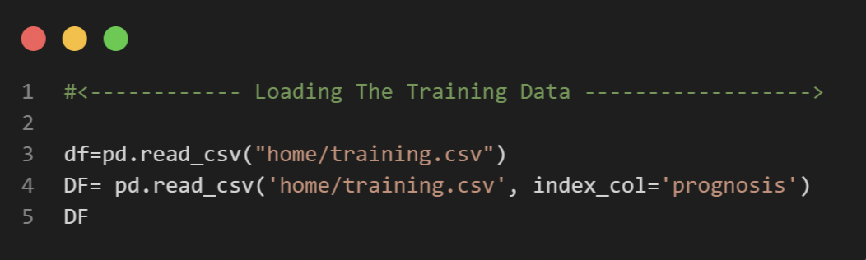
TRAINING DATA

Slide 8
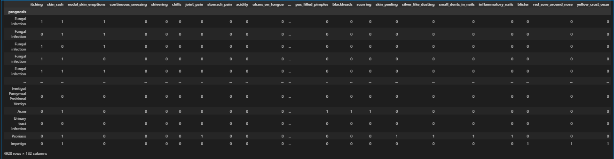
TRAINING DATA

Slide 9
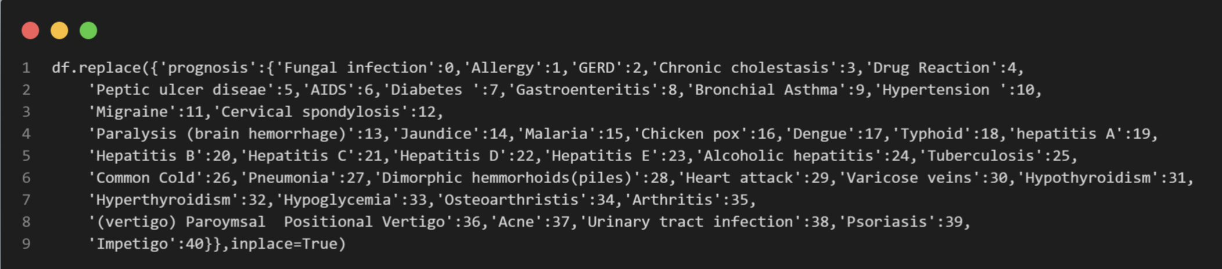
TRAINING DATA PREPROCESSING

Slide 10
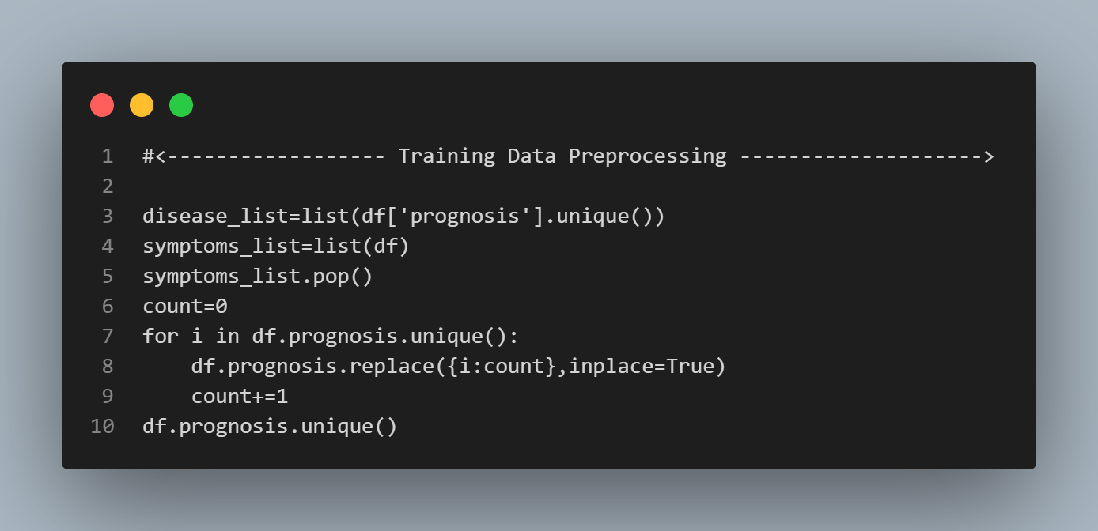
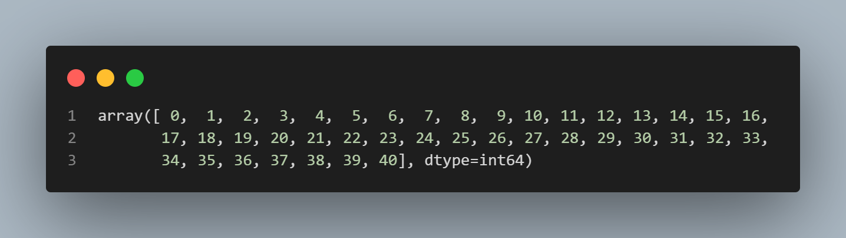
TRAINING DATA PREPROCESSING

Slide 11
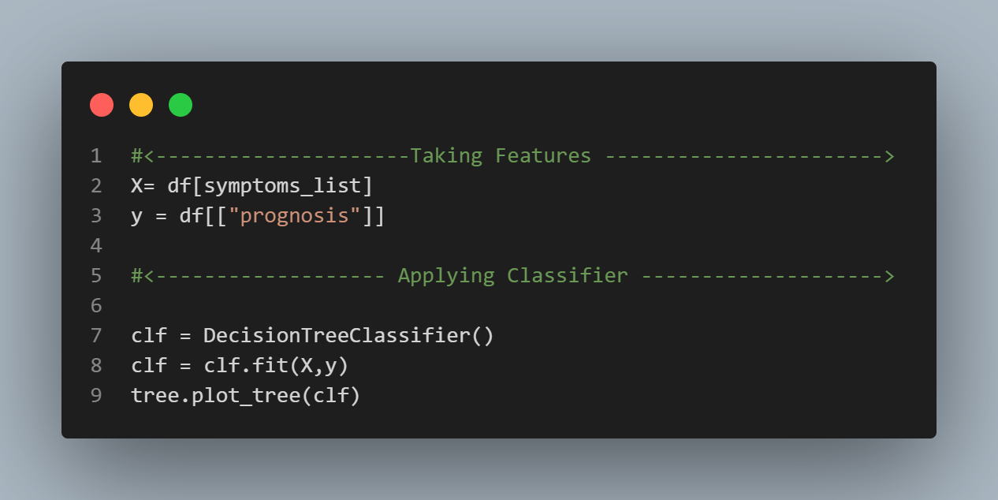
Training Model

Slide 12
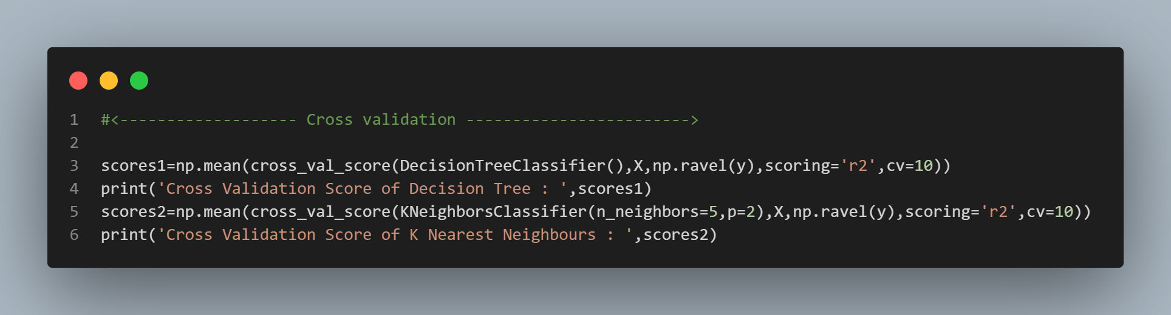
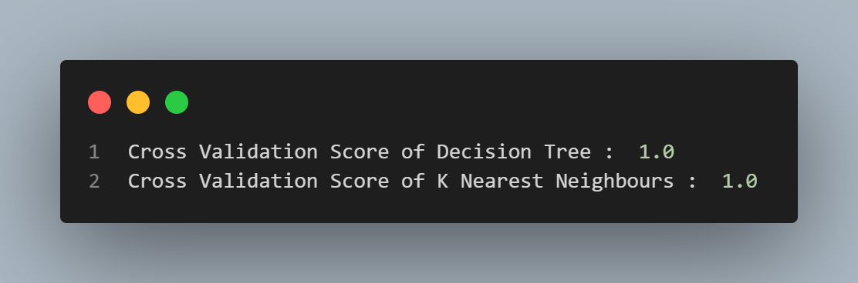
Comparison

Slide 13
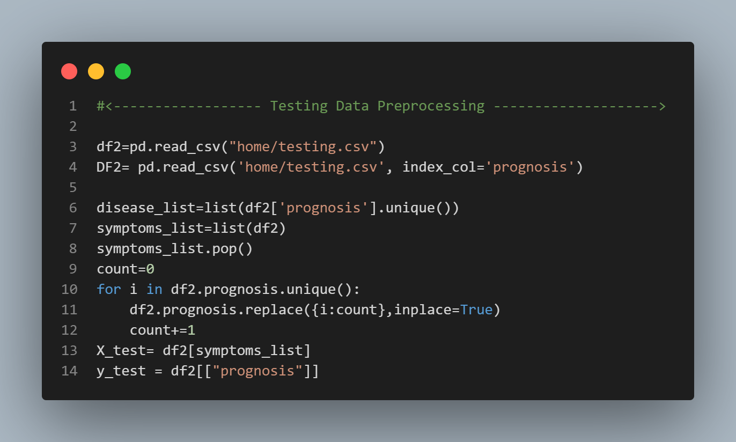
TESTING DATA PREPROCESSING

Slide 14
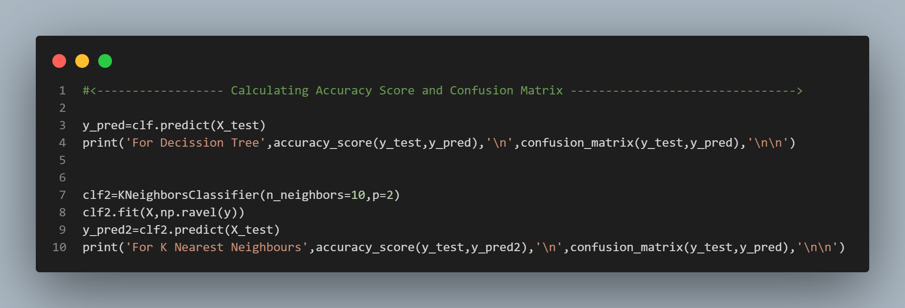
Accuracy Score and Confusion Matrix

Slide 15
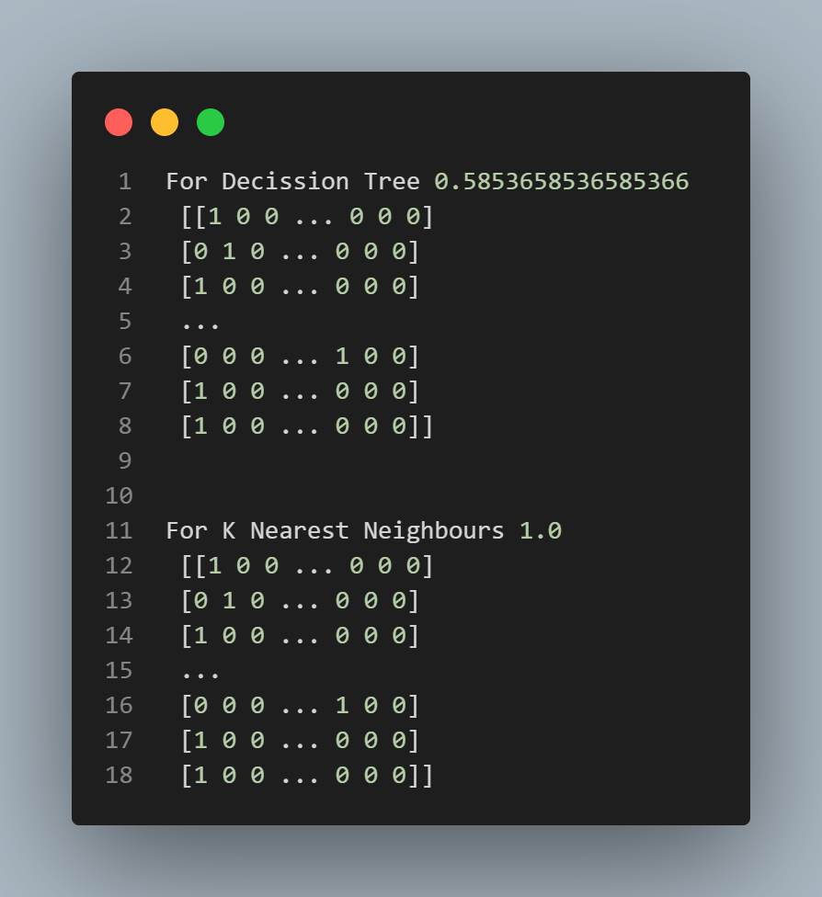
Accuracy Score and Confusion Matrix

Slide 16
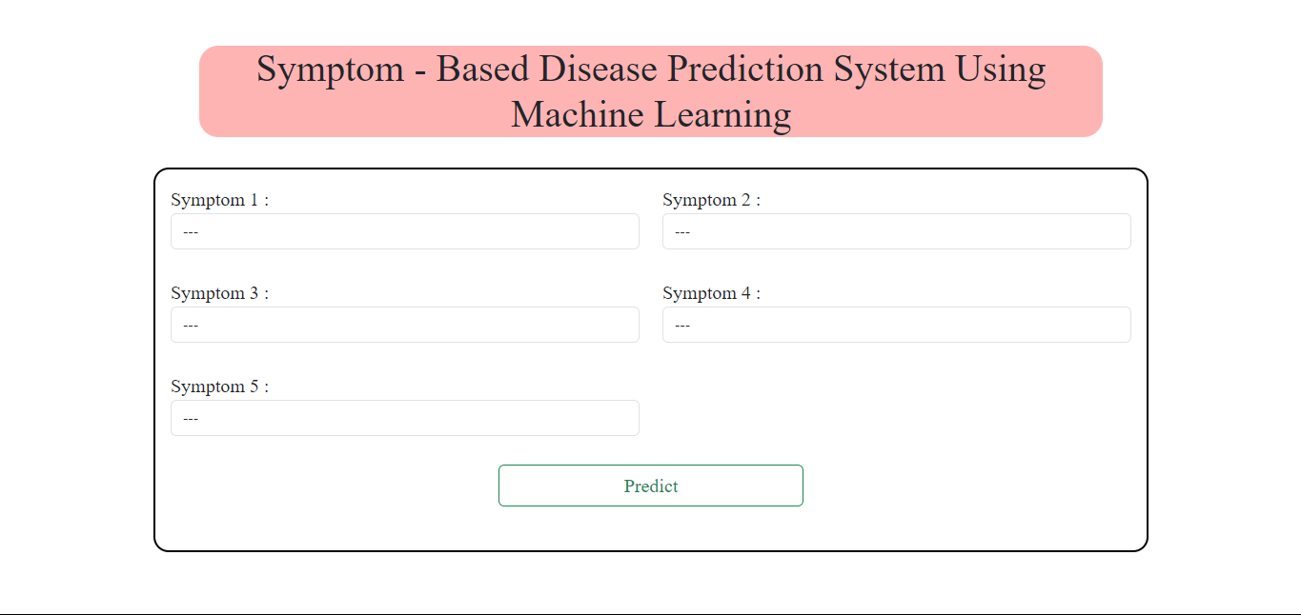
OUTPUT

Slide 17
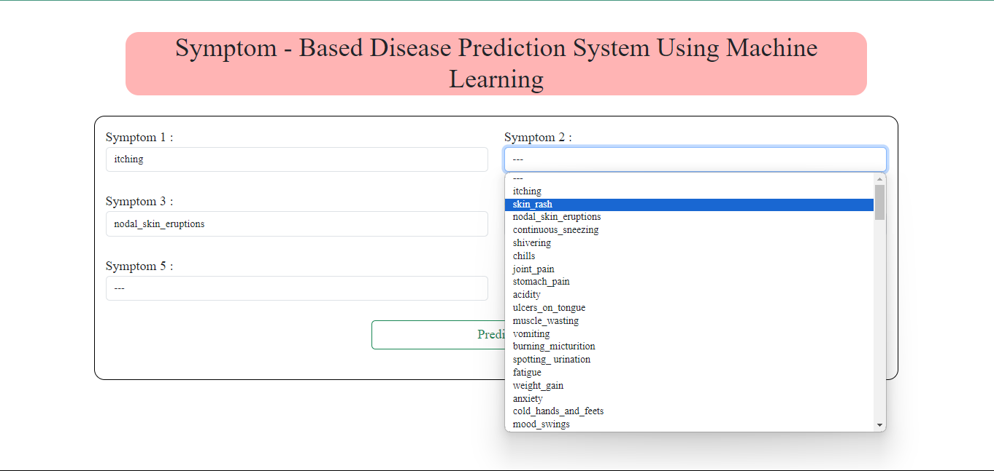
OUTPUT

Slide 18
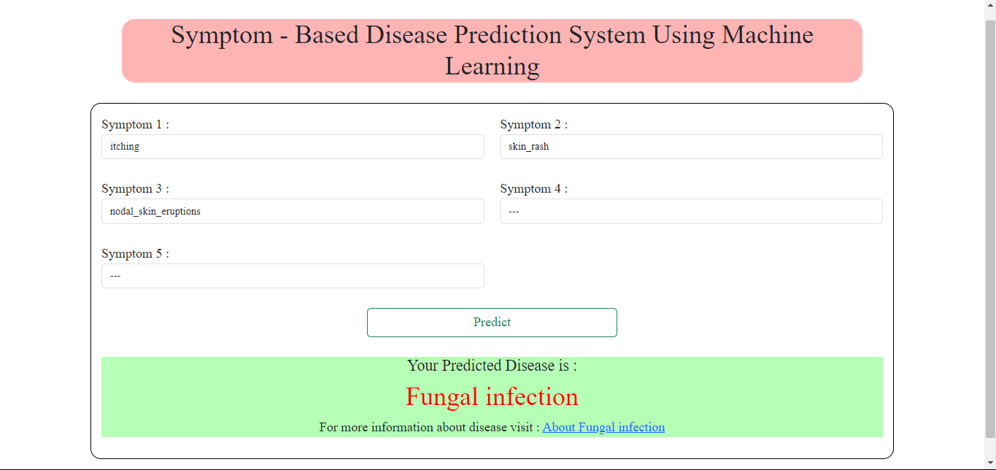
OUTPUT

Slide 19
Over to Code

Slide 20
Compared different models Navie Bayes, Random Forests, K- Nearest Neighbors, Decision Trees.
Among them we got best results in Decision Trees and Random Forests.
As the Computation of Decision tree is done in Observational Space we have chosen Decision Tree to train the Data
More over the data we choose is discrete and is independent makes us more concrete towards Decision Tree Model
CONCLUSION

Slide 21
Video Link
Video Link

